Slide 1
Calculations for Our Autonomous Mission with Camera

Slide 2
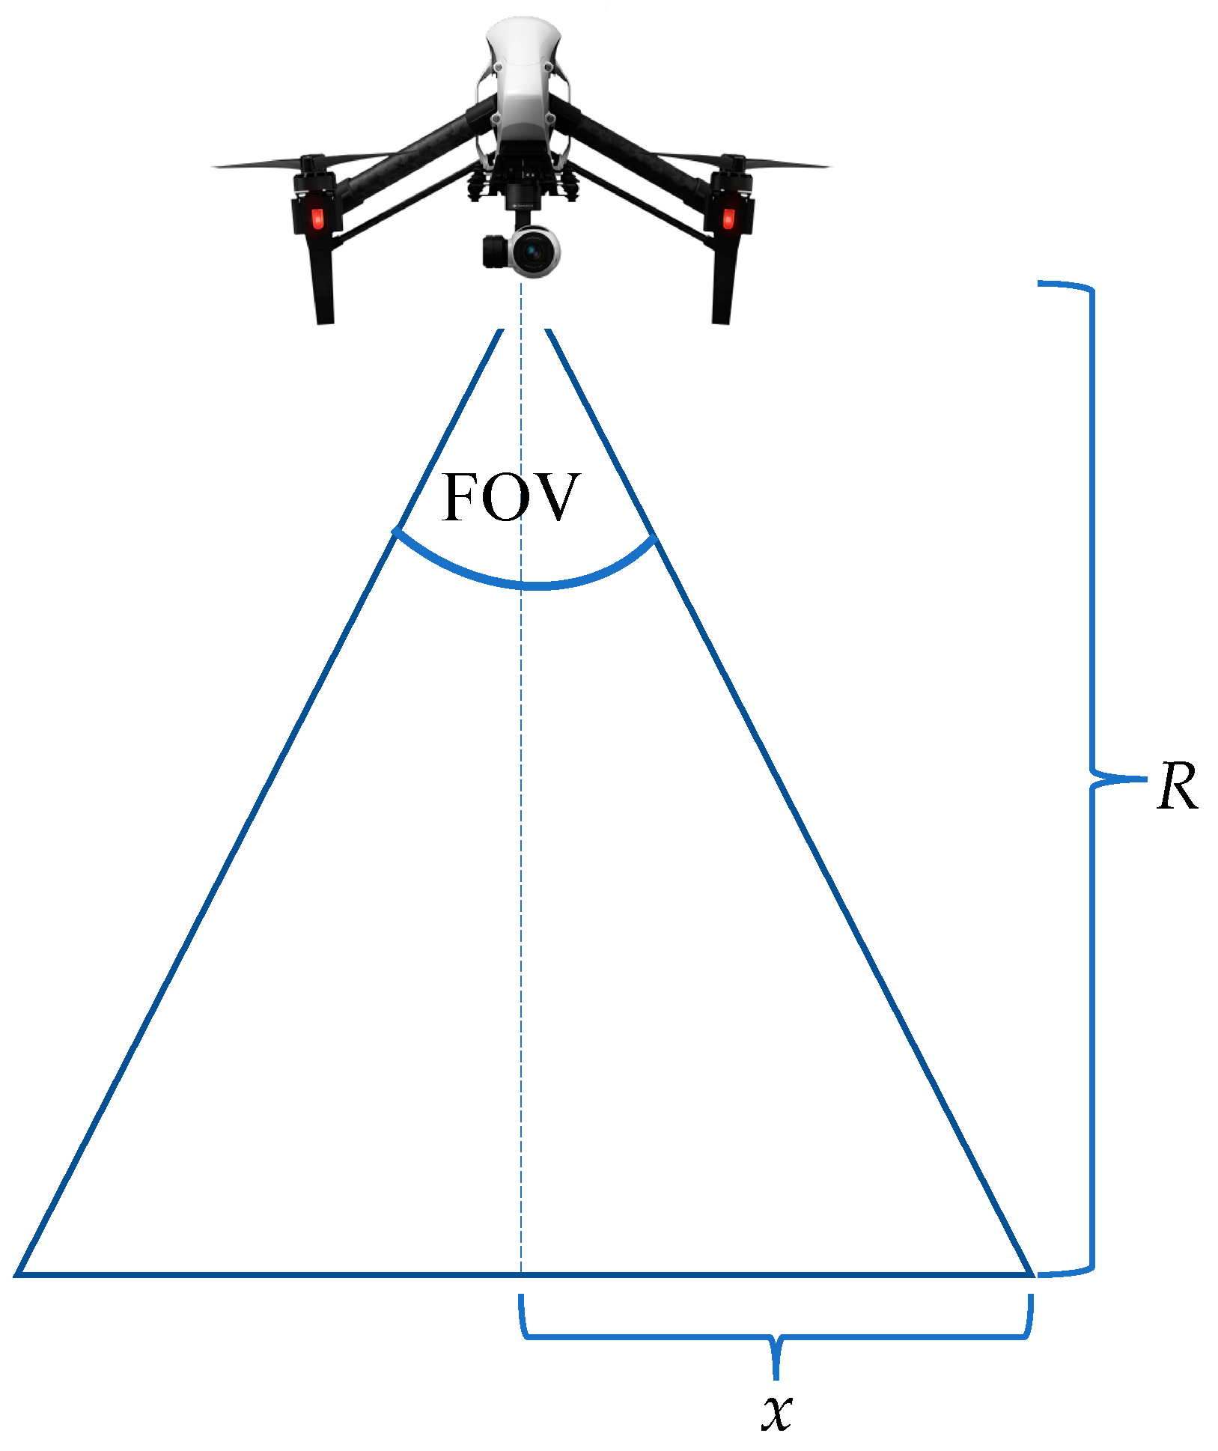
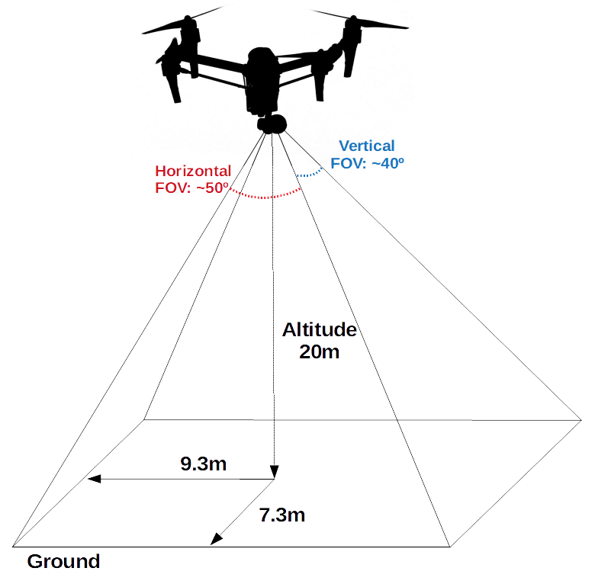
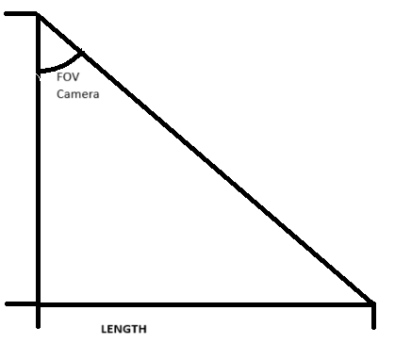
Height

Slide 3


Object detection using SSD Mobile Net V2
Center(x,y)

Slide 4
First we calculate the distance from the detected object in the image frame from the center of the image to the center coordinates of the object detected using the distance formula.
d
Center(x,y)
d=((y2-y1)^2+(x2-x1)^2)^0.5
(320,240)

Slide 5
Now we calculate the angel at which the object is present with respect to the 0 degrees from the center of the frame.
90
d
Center(x,y)
Θ
180
(320,240)
0
270

Slide 6
Now we calculate the yaw angel for the with respect to the heading of our drone and make the new found angel our heading angel of the drone and also note the rotation is clockwise or anti-clockwise. Now we execute yaw motion.
90
Heading Direction Of Drone
- 1
1
d
Center(x,y)
Θ
180
0
(320,240)
270

Slide 7
Now we find the real life distance according the y-axis , as distance is not going to change in rotation keeping the center and radius common, we find the real life distance the frame is covering according to the y-axis. To do this before hand we have found the length to height ratio of the area being covered in the camera keeping the FOV according to our camera 160 degrees and since we know the height of the drone from our Pixhawk we can find the real life distance being covered in the frame. The ratio has been found experimentally before hand.
90
Our experimentation shows ratio= 0.97
Heading Direction Of Drone
d
Center(x,y)
Θ
180
(320,240)
0
270

Slide 8
Now we find the latitude and longitude of the detected object using the haversine formula , taking input from our GPS of our current latitude and longitude and heading angel and the distance we calculated from our calculations of the object.
d
90
Our experimentation shows ratio= 0.97
Heading Direction Of Drone
180
(320,240)
0
270

Slide 9
Math-
Latitude longitude Finding equation
lat2_rad = math.asin(math.sin(lat1_rad) * math.cos(angular_distance) + math.cos(lat1_rad) * math.sin(angular_distance) * math.cos(bearing_rad))
lon2_rad = lon1_rad + math.atan2(math.sin(bearing_rad) * math.sin(angular_distance) * math.cos(lat1_rad), math.cos(angular_distance) - math.sin(lat1_rad) * math.sin(lat2_rad))
For finding the angel of the object centerpoint from the center of image
if centerpt[0]==320:
if centerpt[1]>240:
angle=90
elif centerpt[1]<240:
angle=-90
else:
angle=0.0
else:
angle=math.degrees(math.atan2(centerpt[1]-240,centerpt[0]-320))

Slide 10
For finding real life distance
#Since height to distance ratio is constant
ratio=0.97
distance_in_frame=(vehicle.location.global_relative_frame.alt/ratio)/2
distance_found=yaxis_coord*distance_in_frame/240

